Slide 1
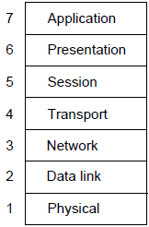
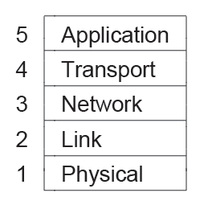
Reference models describe the layers in a network architecture
OSI reference model »
TCP/IP reference model »

Slide 2



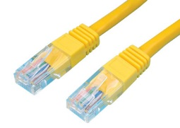
OSI Model
A principled, international standard, seven layer model to connect different systems
– Provides functions needed by users
– Converts different representations
– Manages task dialogs
– Provides end-to-end delivery
– Sends packets over multiple links
– Sends frames of information
– Sends bits as signals
TCP, UDP

Slide 3
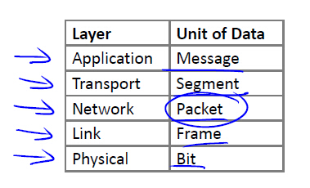
TCP/IP Model
It is based on the TCP/IP model but we call out the physical layer and look beyond Internet protocols.

Slide 4
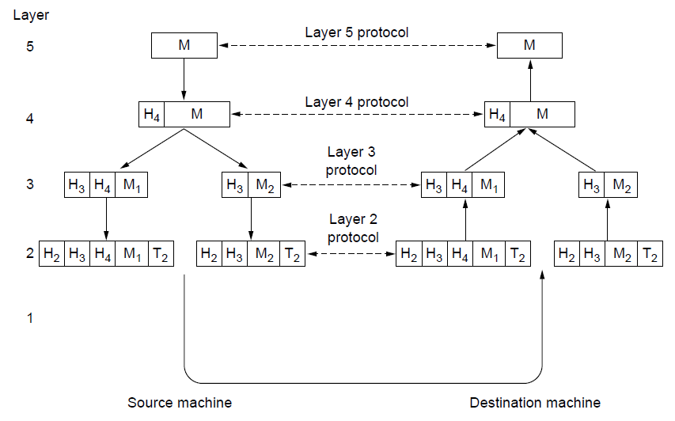
Each lower layer adds its own header (with control inform-action) to the message to transmit and removes it on receive
Layers may also split and join messages, etc.

Slide 5
OSI:
Very influential model with clear concepts
Models, protocols and adoption all bogged down by politics and complexity
TCP/IP:
Very successful protocols that worked well and thrived
Weak model derived after the fact from protocols

Slide 6
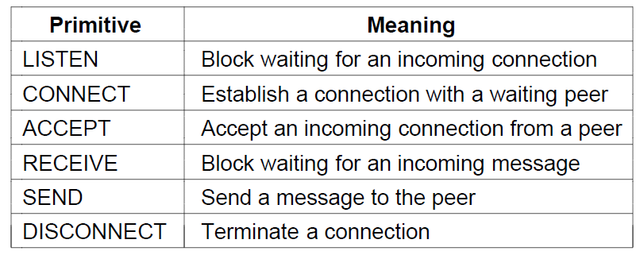
A service is provided to the layer above as primitives
Hypothetical example of service primitives that may provide a reliable byte stream (connection-oriented) service:

Slide 7
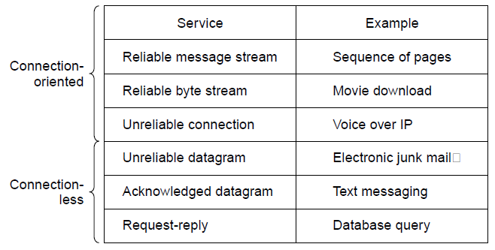
Service provided by a layer may be kinds of either:
Connection-oriented, must be set up for ongoing use (and torn down after use), e.g., phone call
Connectionless, messages are handled separately, e.g., postal delivery

Slide 8

Connection-Oriented Service
Like human "handshaking protocol"
Comes bundled with several other services, including reliable data transfer, flow control and congestion control.
TCP (Transmission Control Protocol) is defined in the Internet Request for Comments RFC 793

Slide 9
Connectionless Service
No handshaking
Data can be delivered faster
No provision for flow control or congestion control
Provided by UDP (User Datagram Protocol) which is defined in the Internet Request for Comments RFC 768
Internet phone, audio-on-demand, and video conferencing

Slide 10
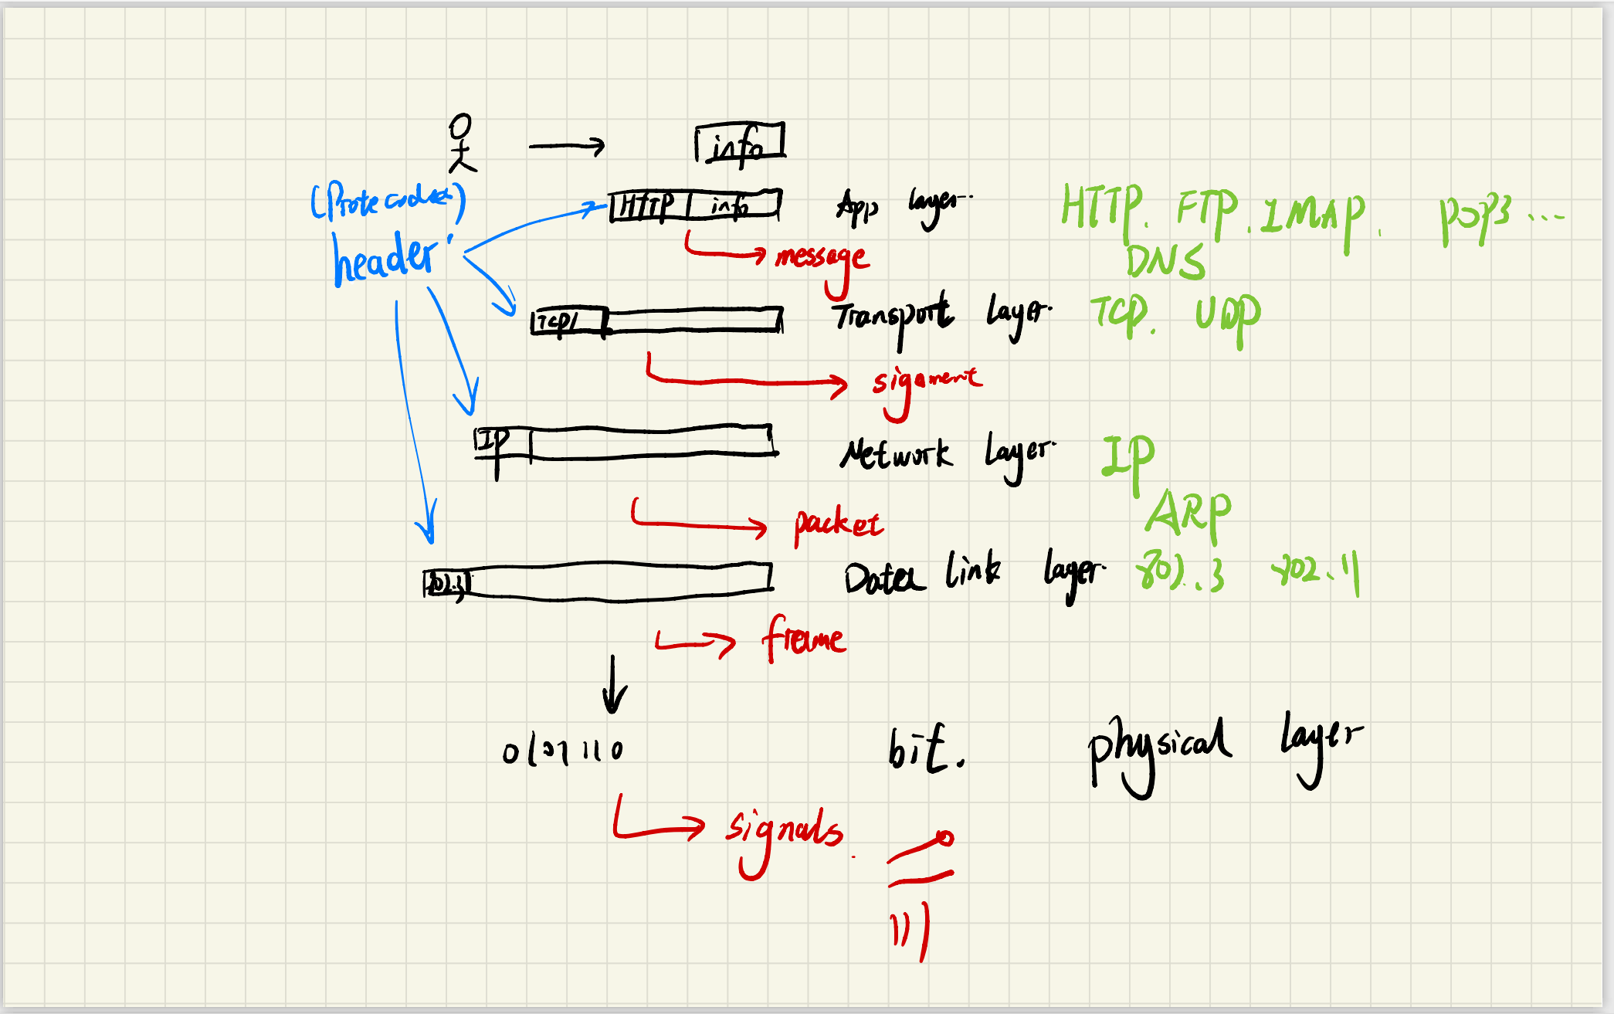

Slide 11
